Slide 1
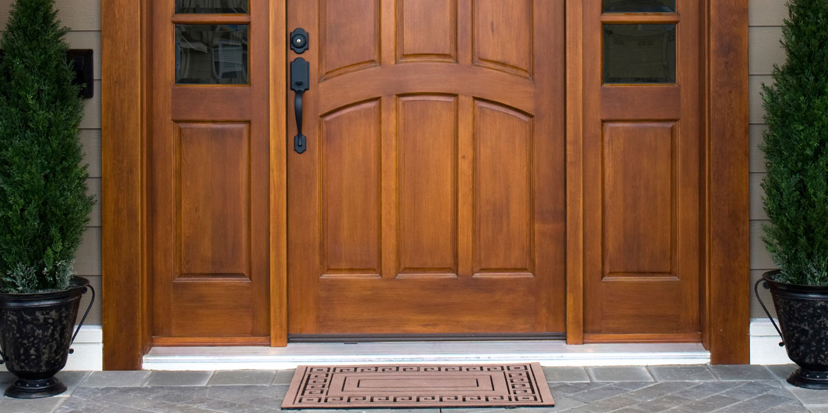
Systems for exterior windows and doors
-Water-borne products have mostly replaced solvent-borne products
-Water-borne products are fast drying and they have very good exterior durability
-Good stacking properties needed especially for door paints
-Often separate primer and top coat but also only top coat system is possible
-Top coat mostly applied by airless/air assisted airless spraying
-Primer and impregnation also by dipping and flow coating application
-Drying in conventional oven temperature 30-40°C
-It is important to use colored product both as primer
and top lacquer. Then resistance against sunlight
is best possible and cracking and peeling minimum

Slide 2
Water-borne lacquers for windows and doors
Pinja Wood Stain
-Water-borne tintable wood stain
-First layer, colouring of the wood
Pinjalac HB
-Very thixotropic lacquer
-Tintable with Akvi Tone colorants
-Very clear film even if higher film thickness
Pinjalac Solid Dipp
-For dipping and flow coating application
Pinja Color Plus
-Semi-trasparent wood stain and exellent exterior durability
-Longer maintenance interval
Relacquering Unica Super or Merit Jahti

Slide 3
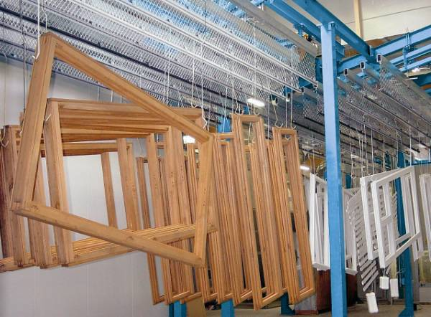
Typical lacquer systems for windows and doors
3 -layer systems
1x 80-120 µm Pinja Wood Stain colored
2x 125-150 µm Pinjalac HB colored
1x 80-120 µm Pinja Wood Stain
2x 125-150 µm Pinja Color Plus colored
4 -layer system for deep pore wood types (oak)
1x 80-120 µm Pinja Wood Stain colored
1x 80-120 µm Pinjalac Solid Dipp
2x 125-150 µm Pinjalac HB colored

Slide 4
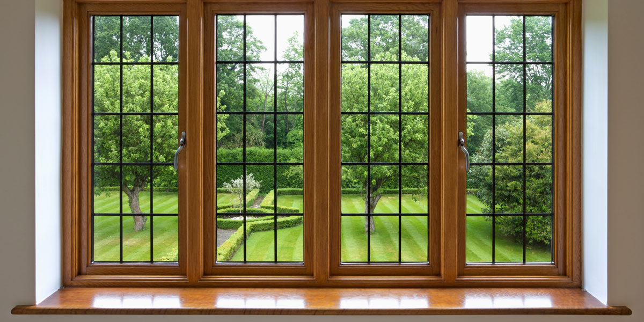
Solvent-borne lacquers for windows and doors
Pinjasol Color
-Solvent-borne wood stain
Merit Jahti 20, 80
-1-component urethanealkyd lacquer
Typical lacquer system
1x 80-120 µm Pinjasol Color colored
2x 100-150 µm Merit Jahti colored

Slide 5
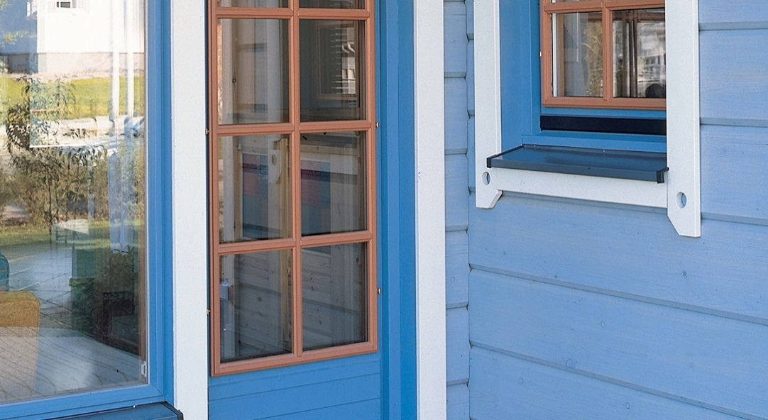
Semi-transparent stain systems for windows and doors
2x 80-120 µm Pinja Wood Stain colored
or
2x 80-120 µm Pinja W-Oil colored
or
2x 80-120 µm Pinjasol Color colored

Slide 6
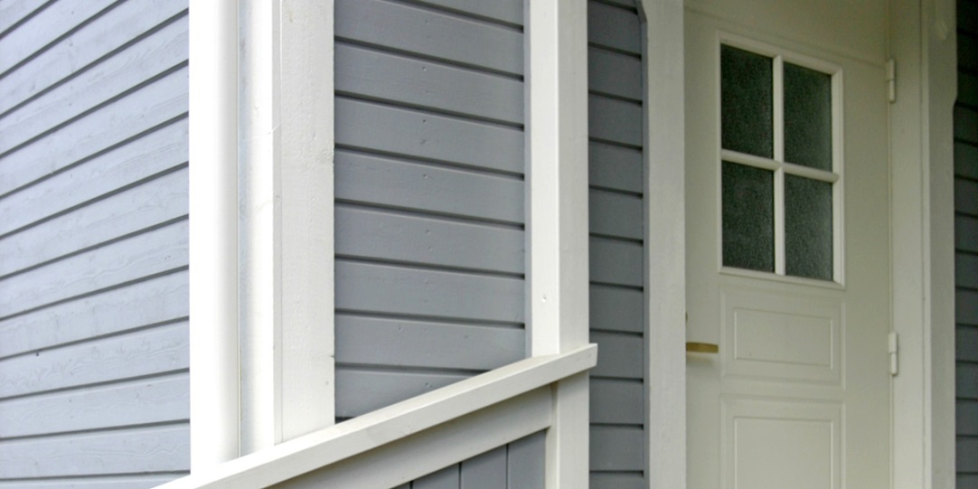
Water-borne paints for exterior windows and doors
Pinja Flex Primer
-standard quality
Pinja Flex Isolator
-isolating primer for pine, larch etc.
-retards the bleeding of the wood resins
Pinja Flex 30
-tintable acrylic top coat
New Pinja Flex Combi 25, 35
-tintable polyacrylate top paint
-very good scratch resistance
Repainting Unica Akva

Slide 7
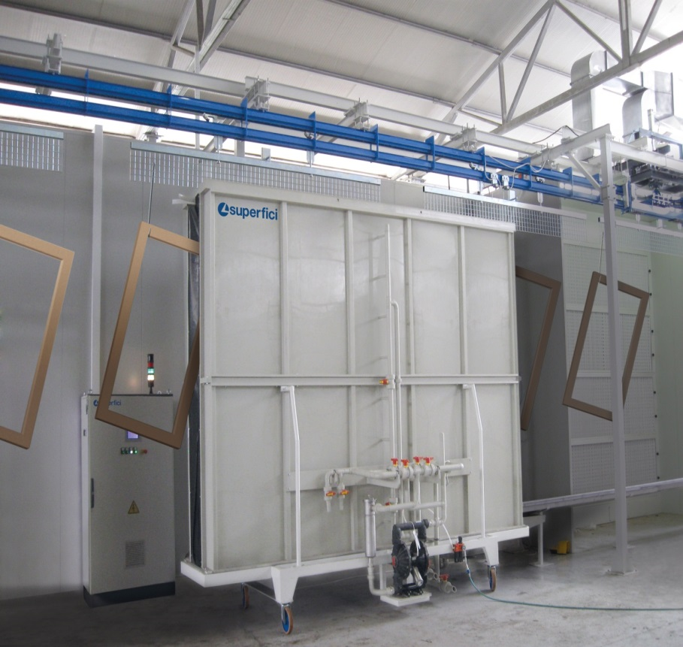
Water-borne paint systems exterior for windows and doors
2 -layer systems
1x 125-150 µm Pinja Flex Primer
1x 125-150 µm Pinja Flex Combi 25, 35
2x 125-150 µm Pinja Flex Combi 25, 35
3 -layer system with priming oil. Improved resistance
to blue stain and rot
1x 80-100 µm Pinja Color Oil or Pinja Wood Stain
2x 125-150 µm Pinja Flex Combi 25, 35
3 -layer system for bleding wood types like larch
2x 125-150 µm Pinja Flex Isolator
1x 125-150 µm Pinja Flex Combi 25, 35

Slide 8
Pinjadur Primer
Pinjadur 30
Water-borne polyurethane products for exterior windows and doors
Pinjadur Primer
-2-component water-borne exterior primer
-Excellent adhesion to solid wood and hdf-board
-Exellent water and humidity resistance
-Minimal swelling of the wood and hdf -fibers
Pinjadur 30
-2-component top paint
-Excellent adhesion
-Exellent water and humidity resistance
-Very good exterior durability, minimal gloss change
-Hard, very good scratch and impact resistance

Slide 9
Pinjadur Primer and Pinja Flex Combi 25 paint systems
Typical systems:
Water-borne pu -primer and acrylate top paint system
1x Pinjadur Primer 125-150 µm
1x Pinja Flex Combi 25 125-150 µm
Water-borne pu -primer and pu -top paint system
1x Pinjadur Primer 125-150 µm
1x Pinjadur 30 125-150 µm

Slide 10
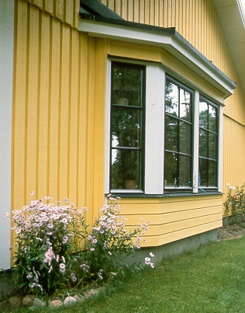
Solvent-borne paints for windows and doors
Diccoplast Elastic Primer
-elastic modified acid catalyzed primer
Diccodur Primer
-polyurethane primer
Dicco Flex 30
-elastic modified amino resin top paint

Slide 11
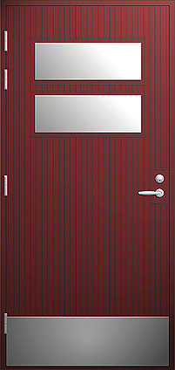
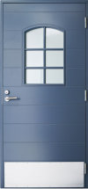
Solvent-borne systems for windows and doors
1x 125-150 µm Diccoplast Elastic Primer
1x 125-150 µm Dicco Flex 30
2x 125-150 µm Dicco Flex 30
1x 125-150 µm Diccodur Primer
1x 125-150 µm Dicco Flex 30
-Repainting Otex + Teho oil paint

Slide 12
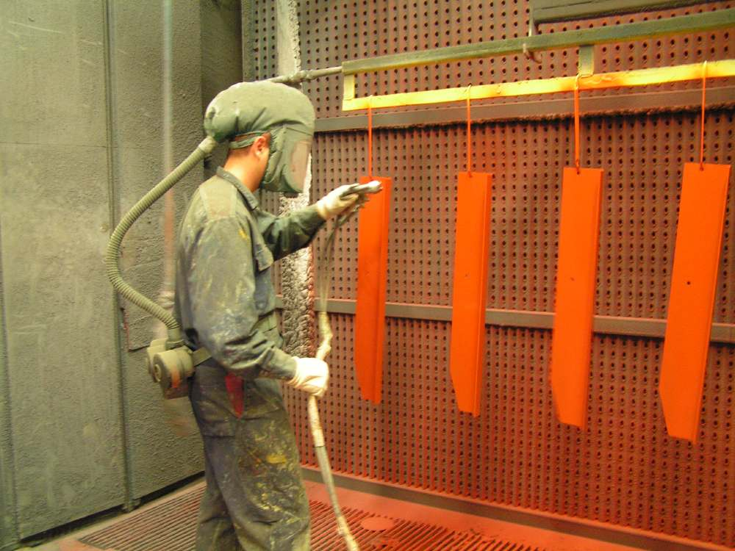
Application methods
Airless and air assisted airless spraying
-Primer and top coat
-Manual spraying
-Electrostatic spraying
-Robot spraying systems
Dipping
-Primers and wood stains
-Dipping time 5-10 s
Flow coating
-Primers and wood stains

Slide 13
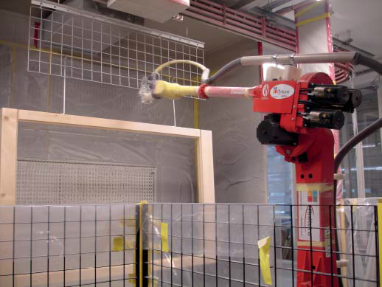
Robot spraying

Slide 14
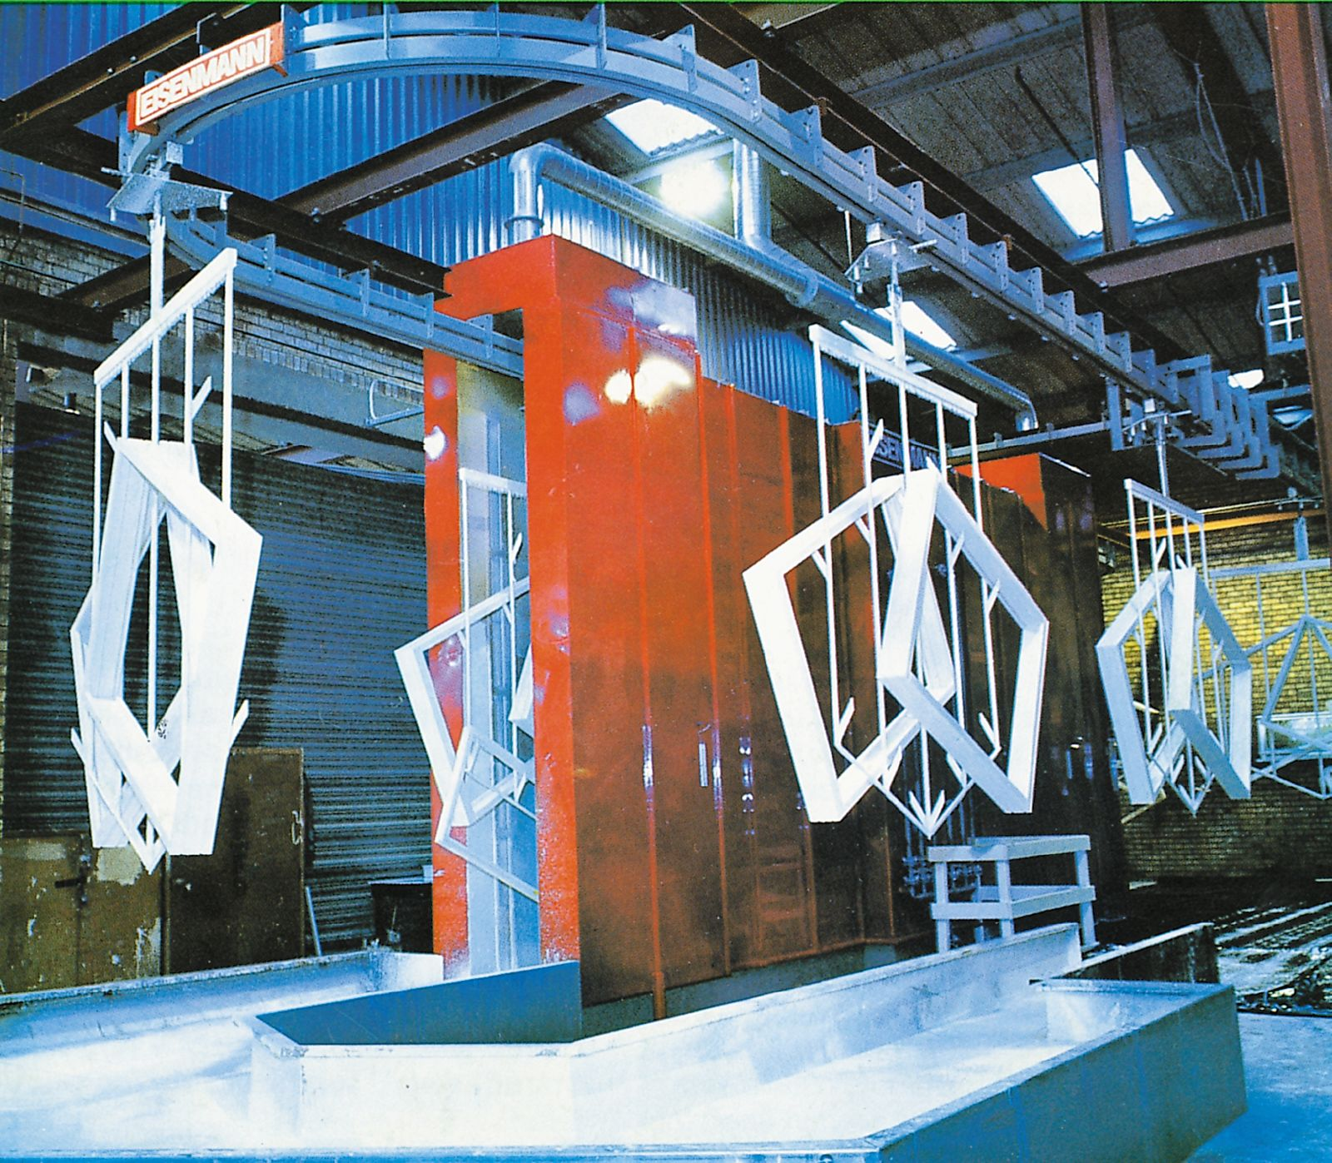
Flow coating application
-white primer

Slide 15
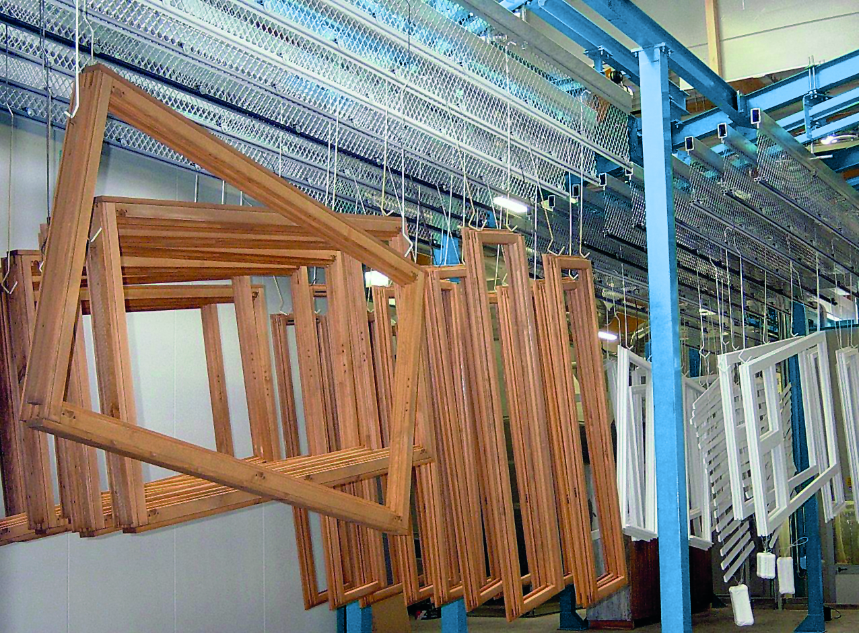
Conventional drying
-Drying temperature 30-40°C
-Typical drying time for water-borne products about 2-4 hours
-Windows hanging in hooks

Slide 16
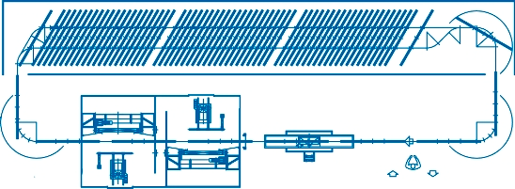
Diagram of typical window painting line:
Flow coater, spraying station and drying tunnel

