Slide 1
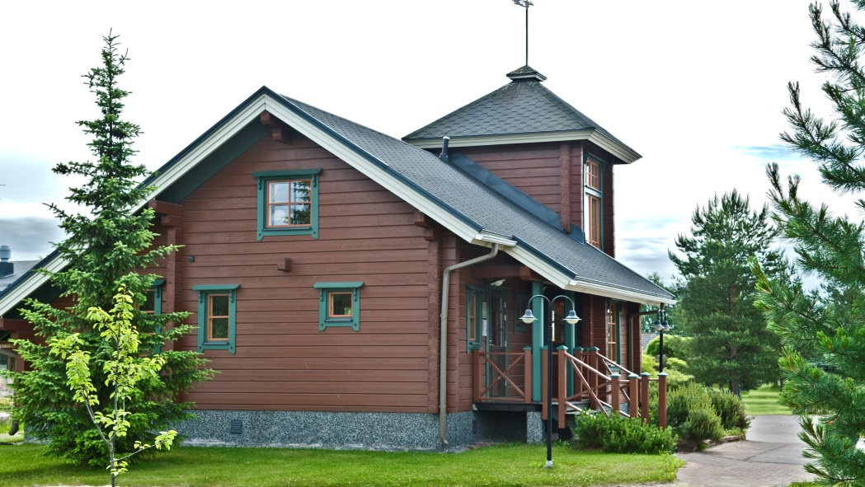
Systems for massive and laminated logs
-Water-borne products mostly used
-Companies need products for temporary transport protection and final colored treatment
-Semi-transparent wood stains and semi-opaque paint systems are suitable for logs
-Opaque paints or lacquers are not recommeded because of possible flaking problems (log has tendency to crack and it can cause flaking problem)
-It is important to paint log ends well. It reduce the cracking of the wood
-Typical system 1-2x 80-120 g/m² water-
or solvent-borne product

Slide 2
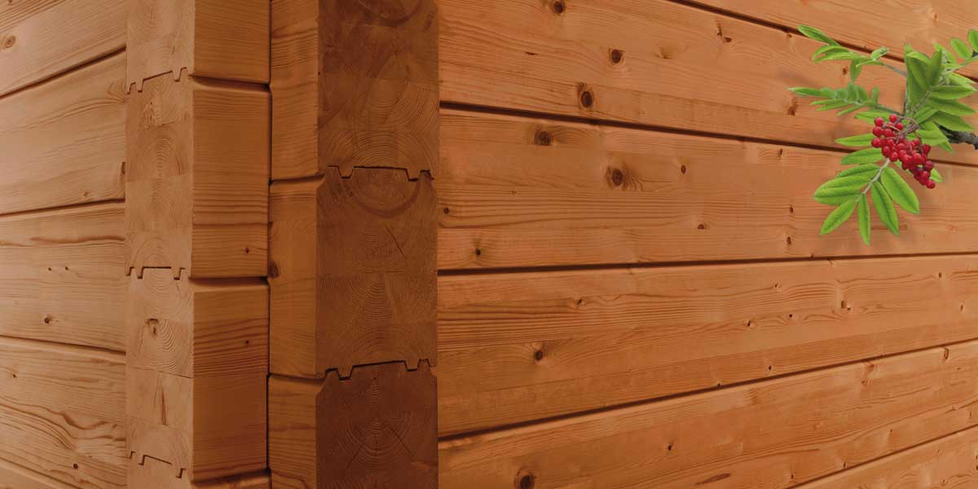
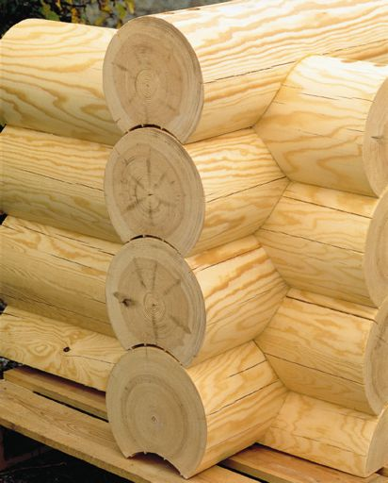
Log types
-Round log
-Laminated log (glued log)
-Planed log

Slide 3
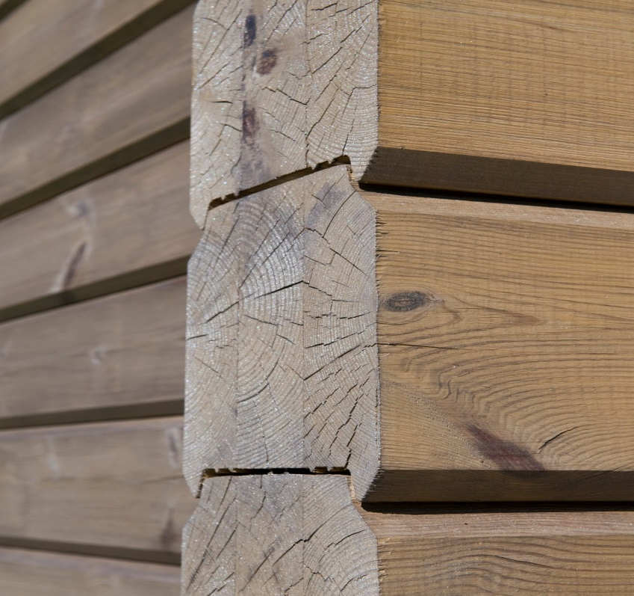
Water-borne semi-transparent wood stains
Pinja Wood Stain
-Tintable water borne wood stain
-Akvi Tone and Avating tinting
-Dipping, flow coating, spraying,
vacuum, brushing
Pinja Color
Pinja Color HB (higher viscosity)
-Tintable water borne wood stain
-Avatint tinting
-Dipping, flow coating, spraying,
vacuum coating, brushing
-Repainting with Valtti Color and Valtti Akvacolor

Slide 4
Water-borne semi-transparent wood stains
Typical systems
2x 80-120 g/m² Pinja Wood Stain
Best protection:
1x 80-120 g/m² Pinja Priming Oil
2x 80-120 g/m² Pinja Wood Stain

Slide 5
Water-borne semi-transparent wood stains
Pinja Color Plus
-Recommended for laminated logs but
not round massive logs
-Repainting with Valtti Plus Kesto
System:
1x Pinja Wood Stain
2x Pinja Color Plus

Slide 6
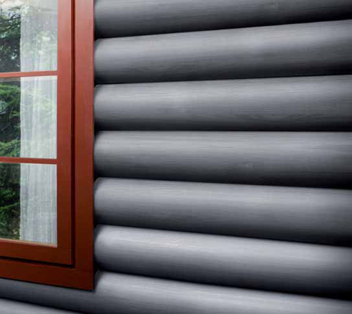
Water-borne semi-opaque wood stain
Pinja Top
-Tintable water-borne semi-opaque
wood stain
-Avatint –tinting
-Vinha color card
-Spraying application
-Repainting with Vinha

Slide 7
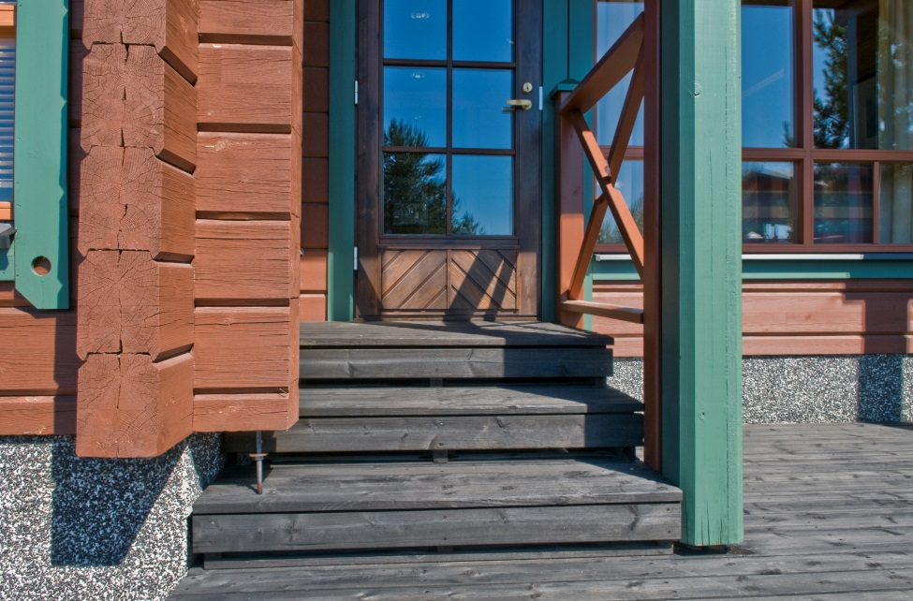
Water-borne semi-transparent oils
Pinja W-Oil
-Tintable water borne wood oil
-Akvi Tone and Avatint tinting
-Good water repellency effect
-Dipping, flow coating, spraying,
vacuum, brushing
-Repainting with Valtti Color, Valtti Akvacolor

Slide 8
Solvent-borne clear and semi-transparent wood stains
Pinjasol Color
-Temaspeed Premium tinting
-Dipping, spraying, brushing
-Repainting Valtti Color, Valtti Akvacolor

