Slide 1
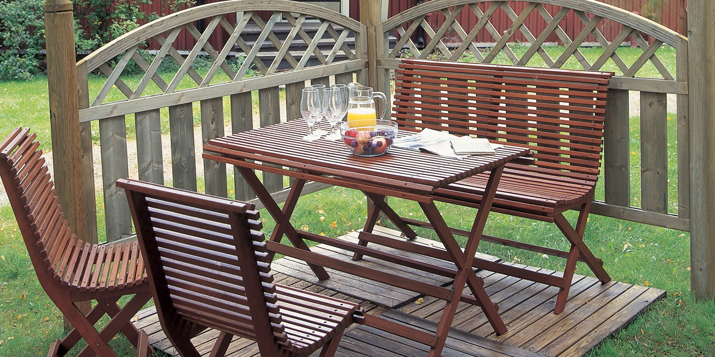
Systems for garden furniture
-Tikkurila offers wide range of water- and solvent-borne products for garden furniture applications
-Mostly water-borne products
-Application by spraying, dipping and flow coating

Slide 2
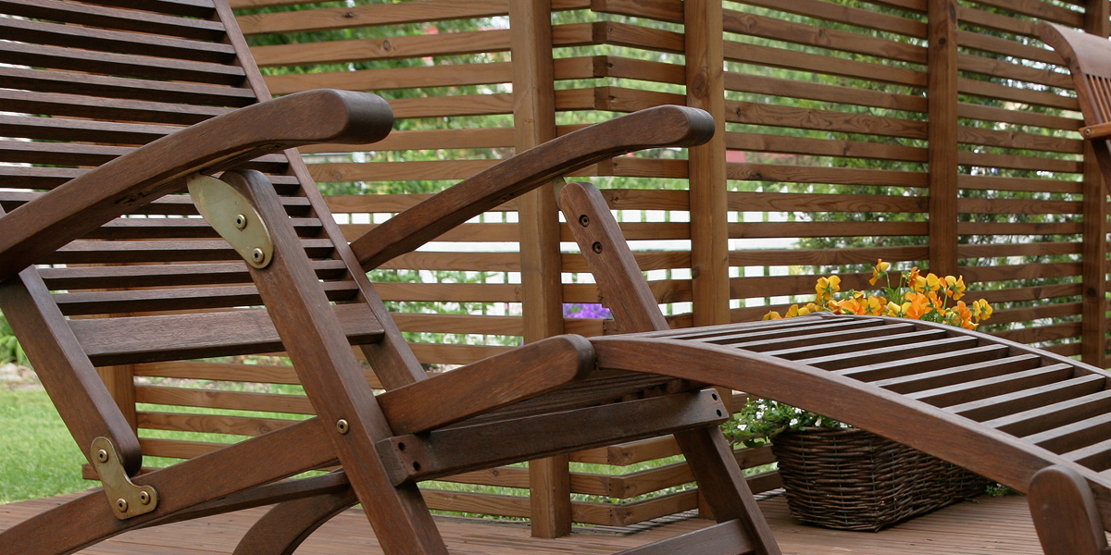
Water-borne wood stains for garden furniture
Pinja Wood Stain
-Akvi Tone or Avatint tinting
-Dipping, flow coating, spraying,
vacuum, brushing
Pinja Color
Pinja Color HB (higher viscosity)
-Avatint tinting
-Dipping, flow coating, spraying,
vacuum coating, brushing
System: 1-2x Pinja Wood Stain or Pinja Color
-Repainting with Valtti Color and Valtti Akvacolor

Slide 3
Water-borne oils for garden furniture
Pinja W-Oil
-Akvi Tone or Avatint tinting
-Good water repellency effect
Pinja Color Oil
-Avatint tinting
-Very good penetration properties
Application: 1-2x Pinja W-Oil or Pinja Color Oil
-Repainting with Valtti Wood Oil, Valtti Color,
Valtti Akvacolor

Slide 4

NEW Pinja Color Plus –woodstain which has long maintanance time
• Fast drying woodstain for claddings and glued log facades
• Higher solid content than normal wood stains -28 vol-%
• Clear and Super Color bases
• Super Color base contains transparent pigments which together with uv-protection agent gives superior sunlight protection
• Maintanance time up to 10 years
• Exellent water and humidity resistance minimise the cracking of the wood
• For planed and fine sawn wood as well as thermo and vacuum impregnated wood
Typical system:
1x Pinja Priming Oil or Pinja Wood Stain
2x Pinja Color Plus

Slide 5
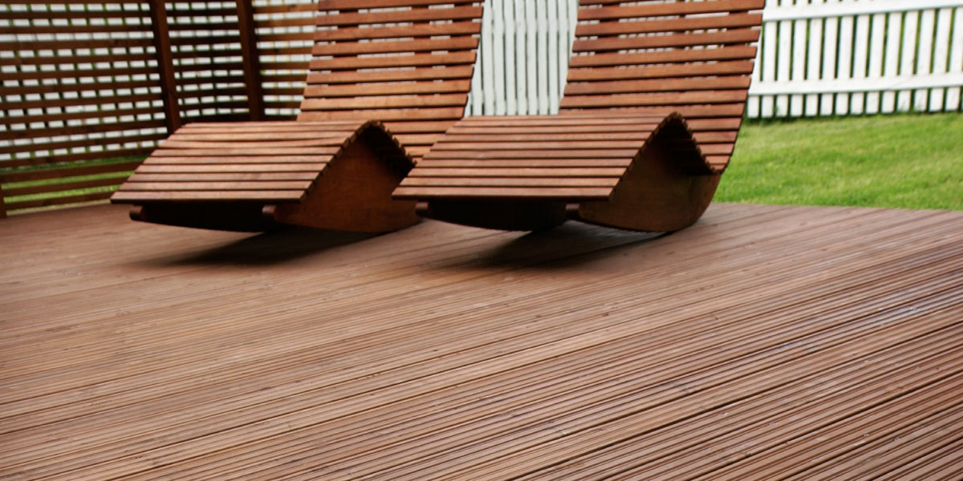
Solvent-borne wood stains for garden furniture
Pinjasol Color
-Temaspeed Premium tinting
-Dipping, spraying, brushing
Pinjasol Lasur
-Temaspeed Premium tinting
-Higher solid content about 23 vol-%
-Good water repellency effect, uv- and
scratch resistance
-Spraying and brushing application
-Application: 1-2x Pinjasol Color or Pinja Lasur
-Repainting with Valtti Color, Valtti Akvacolor

Slide 6
Solvent-borne wood stains for garden furniture
Pinjasol Wax
-Especially suitable for hardwood like oak, akacia
-11 ready made colors
-Solid content about 18 vol-%
-Fast drying and less smelling
-Smooth and silky surface
-Spraying, dipping and brushing application
-Application: 1-2x Pinjasol Wax
-Repainting with Valtti Color, Valtti Akvacolor

Slide 7
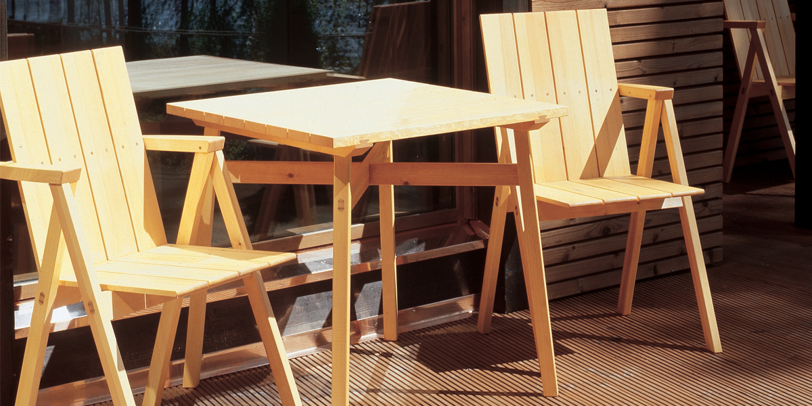
Water-borne lacquers for garden furniture
Pinja Wood Stain
-Water-borne tintable wood stain
-First layer, colouring of the wood
Pinjalac HB
-Very thixotropic lacquer
-Tinting with Akvi Tone colorants
Pinjalac Solid Dipp
-For dipping and flow coating application
Relacquering Unica Super or Merit Jahti

Slide 8
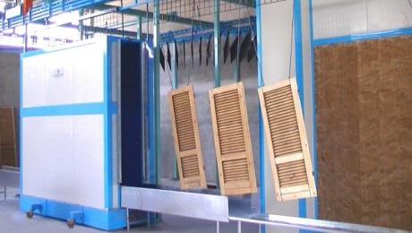
Typical lacquer systems for garden furniture
3 -layer system
1x Pinja Wood Stain
2x Pinjalac HB
Dipping or flow coating systems
2x Pinjalac Solid Dipp
1x Pinja Wood Stain
2x Pinjalac Solid Dipp

Slide 9

Solvent-borne lacquer system
Pinjasol Color
-Solvent borne wood stain
Merit Jahti 20, 80
-1-component polyurethane lacquer
Typical lacquer system
1x Pinjasol Color tinted
1-2x Merit Jahti tinted

Slide 10
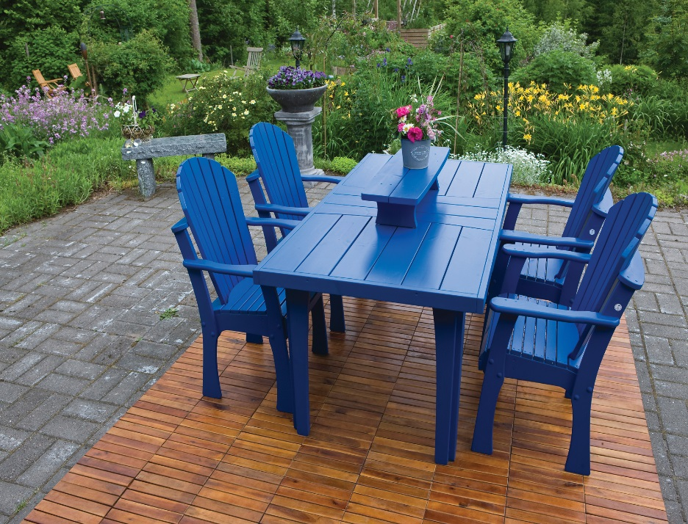
Water-borne paints for garden furniture
Pinja Flex Primer
-standard quality
Pinja Flex Isolator
-isolating primer for pine, larch etc.
-retards the bleeding of the wood resins
Pinja Flex 30
-tintable acrylic top coat
Pinja Flex Combi 25, 35
-faster drying and better scratch resistance
Pinja Top
-special colors for dipping and flow coating application
Repainting Unica Akva

Slide 11
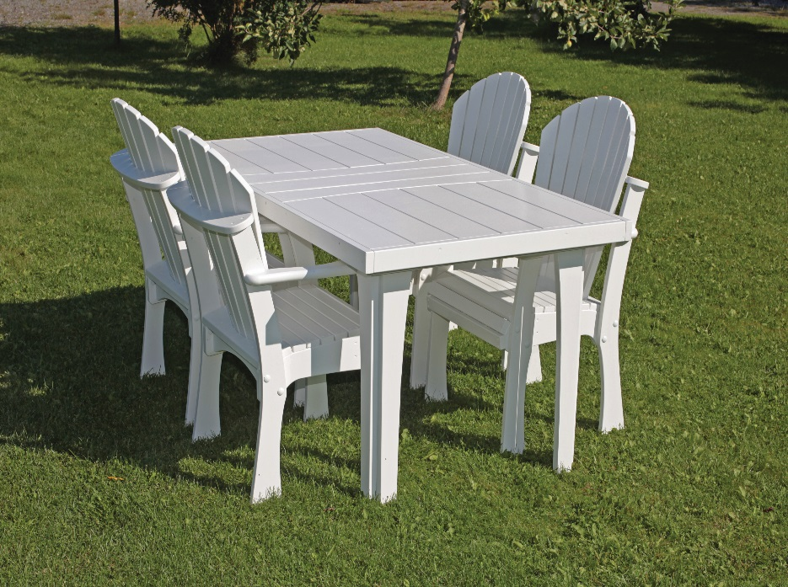
Typical paint systems
2 -layer systems
1x Pinja Flex Primer
1x Pinja Flex 30
or
2x Pinja Flex 30
2x Pinja Flex Combi 25, 35
3 -layer system with priming oil. Improved resistance
to blue stain and rot
1x Pinja Wood Stain
1x Pinja Flex Primer
1x Pinja Flex 30
3 -layer system for bleeding wood types like larch
2x Pinja Flex Isolator
1x Pinja Flex 30

Slide 12
Typical paint systems
Flow coat paint system
1-2x Pinja Wood Primer white
1x Pinjalac Solid Dipp

Slide 13
Production of garden furniture:
-cutting of wood
-planing
-drilling
-sanding, assembling, gluening
-painting
-drying

Slide 14
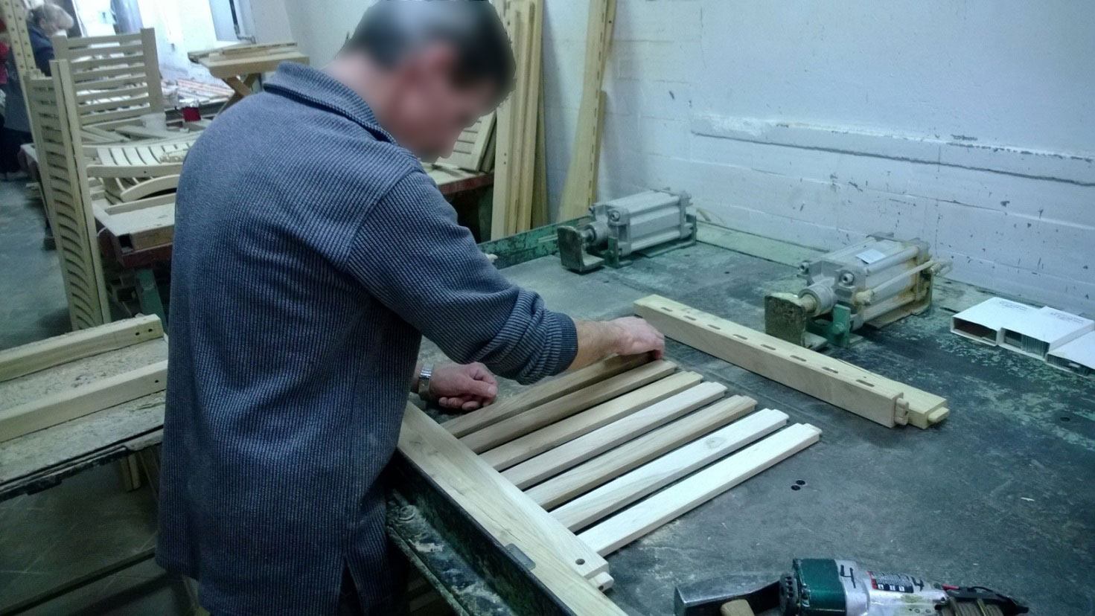
Assembling, gluening

Slide 15
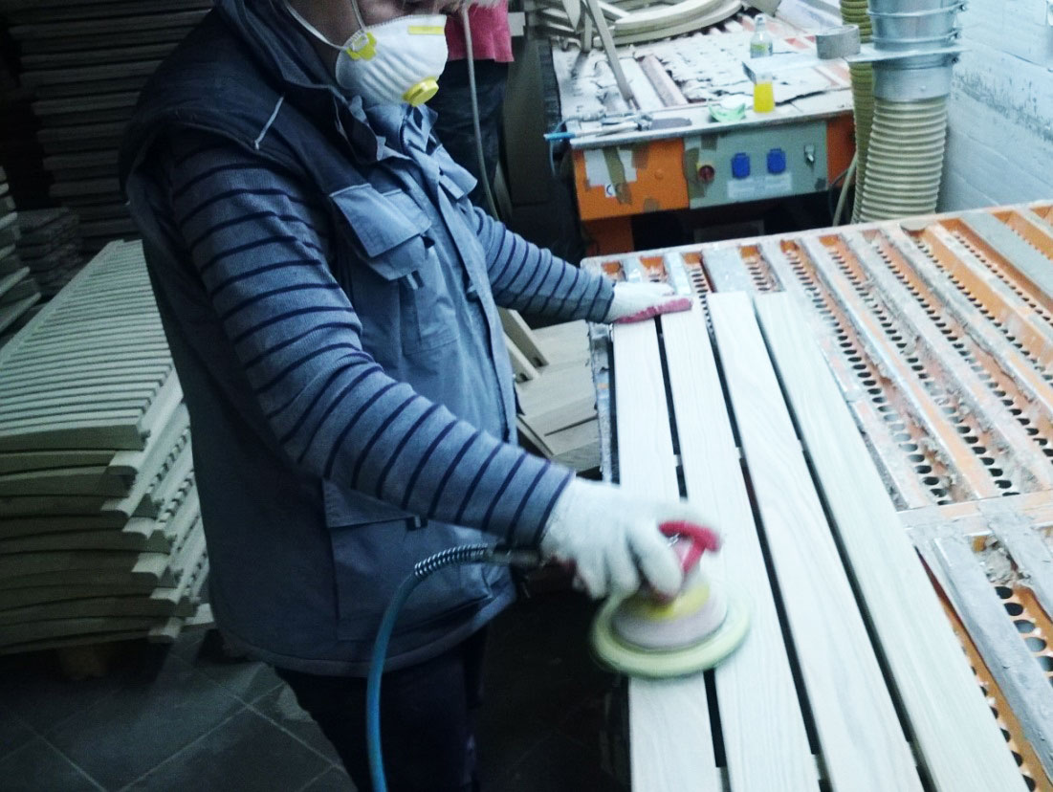
Sanding

Slide 16
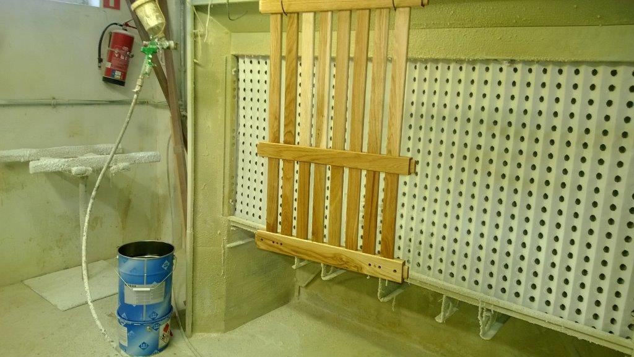
Spraying

Slide 17
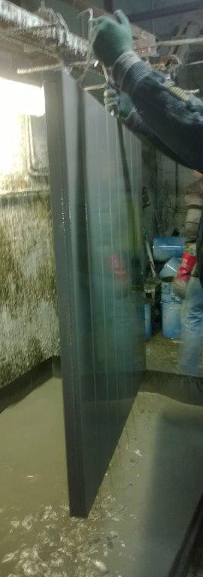
Dipping

Slide 18
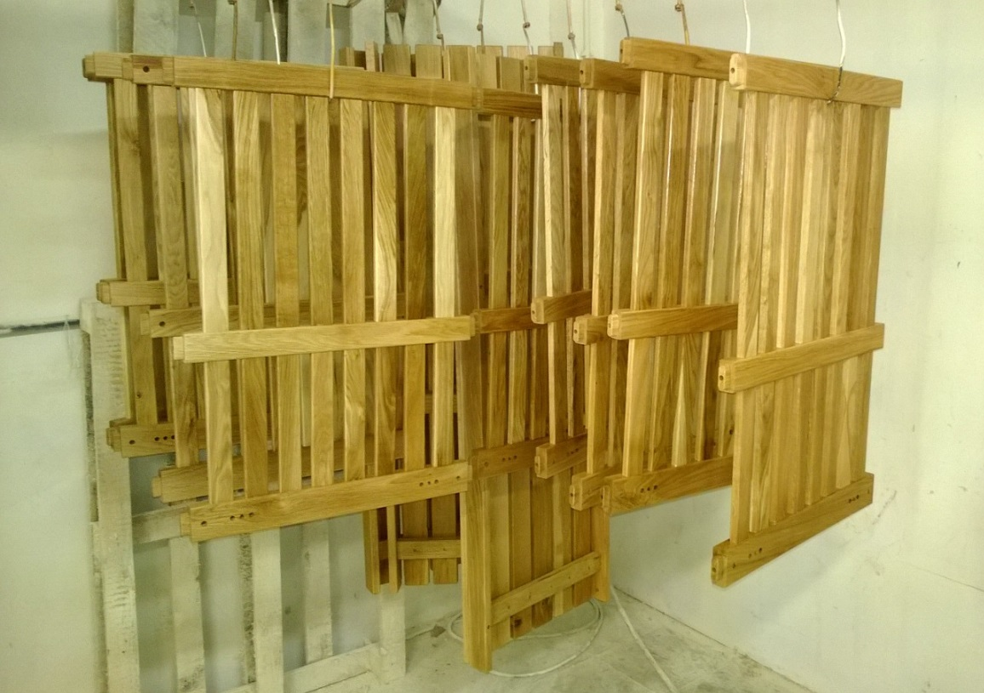
Drying

Slide 19
Flow coat painting video
https://www.youtube.com/watch?v=K6RM3jlJnBs

