Slide 1
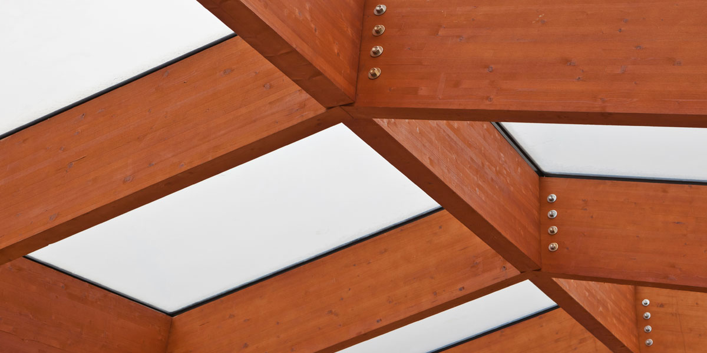
Solutions for construction elements
-Water-borne products are commonly used
-Opaque paint and clear and semi-transparent lacquer systems popular

Slide 2
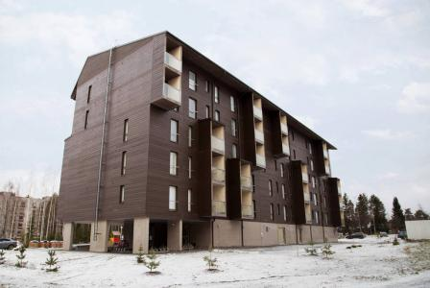
Opaque paint systems
-Typical exterior painting systems:
1x Pinja Pro Primer
1x Pinja Pro or Pinja Top
1x Pinja Opti Primer
1x Pinja Pro or Pinja Top
2x Pinja Pro
2x Pinja Top
2x Ultra Pro 30
Interior painting system:
1-2x Akvi Primer DS + 1x Akvi Top DS 25

Slide 3
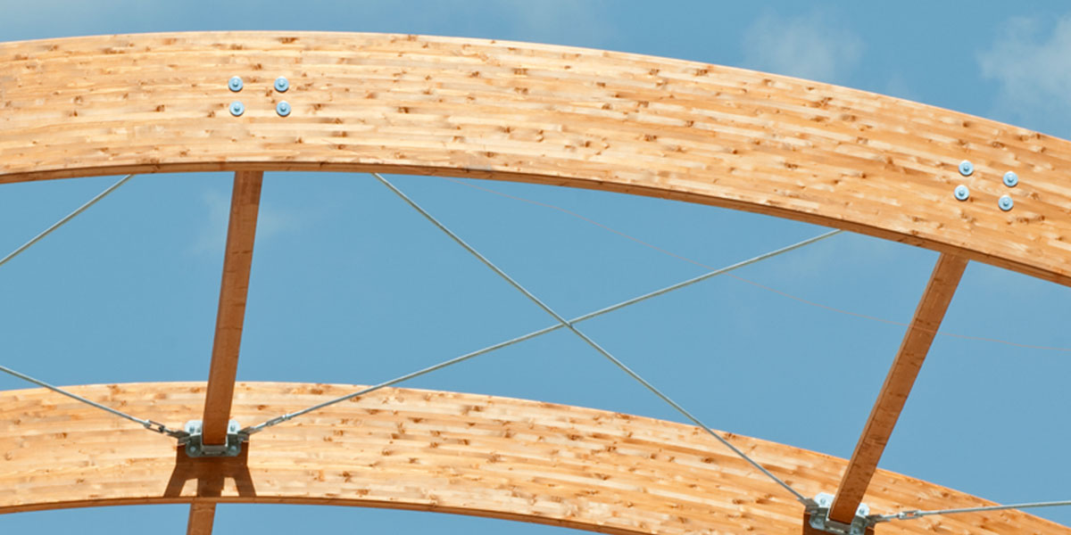
Clear and semi-transparent lacquer systems
Exterior:
1x Pinja Wood Stain + 2x Pinjalac HB
2x Pinjalac HB
1x Pinja Wood Stain + 2x Pinja Color Plus
1x Pinjasol Color + 2x Merit Jahti 20, 80
2x Pinja Wood Stain
Interior:
2x Akvilac FD 25
2x Akvilac Tix FD 25

