Slide 1
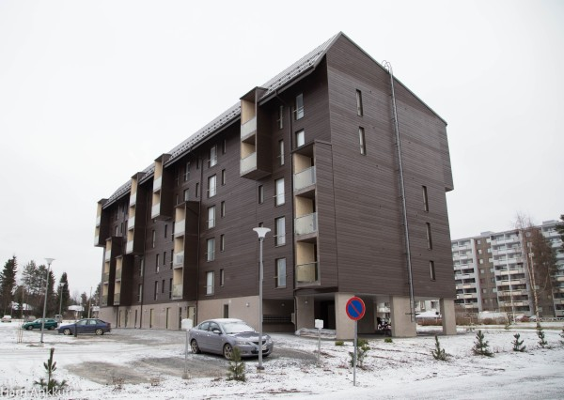
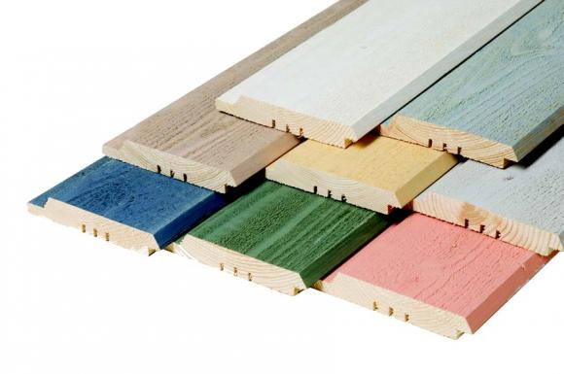
Industrial painting systems for exterior claddings
-Wide product range for different kind of application methods and drying systems
-Traditional alkyd primers, acrylate top coats as well as fast drying polyacrylate top coats
-Wide color range and possibility for onsite tinting with Avatint -colorants and tinting machines

Slide 2
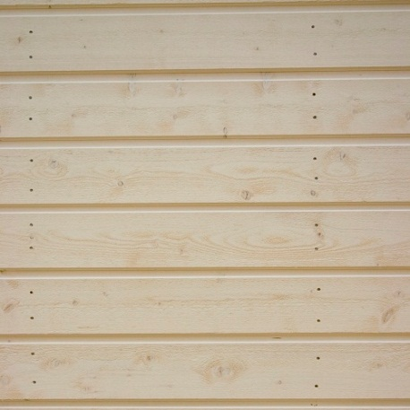
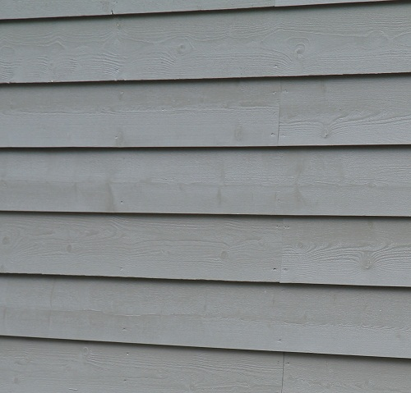
Benefits of industrial painting compared painting on construction site
-Wood is stored in well ventilated and sheltered area and wheather does not impair the wood quality
-Control of wood humidity and wood purity before painting
-Controlled application and drying conditions improve painting quality
-Drying in conventional oven improves adhesion as well as water and humidity resistance etc.
-Painting of wood panel three or four sides effectively and regular controlled paint film thickness
-Fast and cost effective painting compared to the painting on construction site
-Nowadays, construction work is performed year round and painted wood elements are installed at a time when finishing cannot be done outdoors.

Slide 3
Wood preparation
-Wood must be free of dirt, dust and mould
-Wood suface must be clean and dry
-Moisture content of the wood has to be below 20 %
-During application and drying temperature of the air, substrate and paint must be over +10°C and relative humidity of the air below 70 %.
-Good ventilation during drying is important

Slide 4
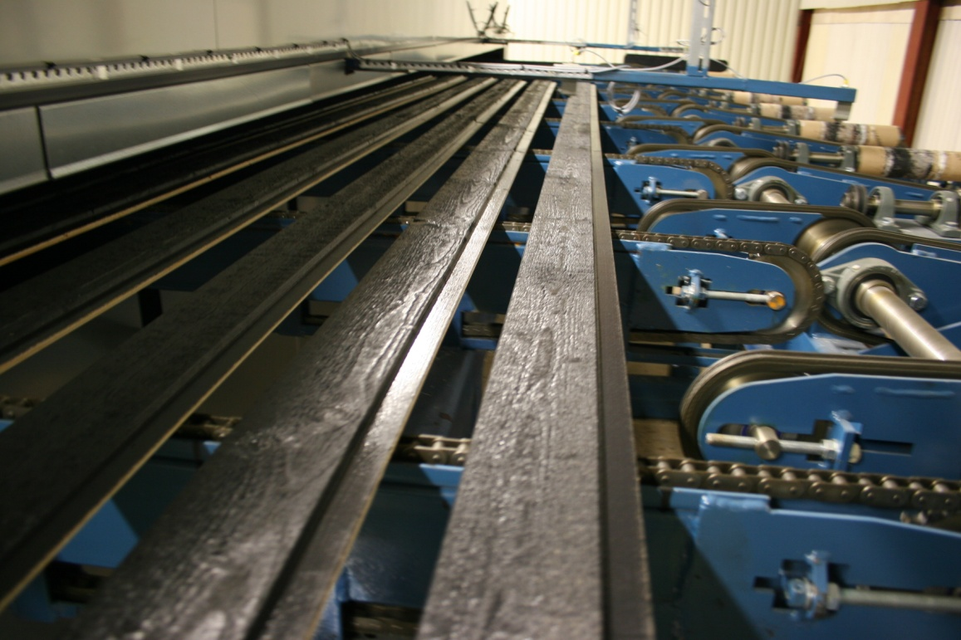
Products for exterior claddings
-primers
Pinja Pro Primer
-Water borne alkyd primer
-Only for sawn wood
-Stackable when paint not completely dry
-White, A- and C-base
-Spraying, vacuum and brushing machine application
Pinja Opti Primer
-Water borne alkyd primer, thinning 1:1with water
-Both sawn and planed wood
-Improved adhesion compared to Pinja Pro Primer
-Stackable when paint not completely dry
-White, A- and C-base
-Spraying, vacuum and brushing machine application

Slide 5
Products for exterior claddings
-top coats
PinjaTop
-Water borne acrylic-alkyd semi-opaque top coat
-Valtti Opaque color card
PinjaPro
-Water borne acrylic-alkyd top coat
-Color card for exterior paints
Slow drying compared to Ultra Pro

Slide 6
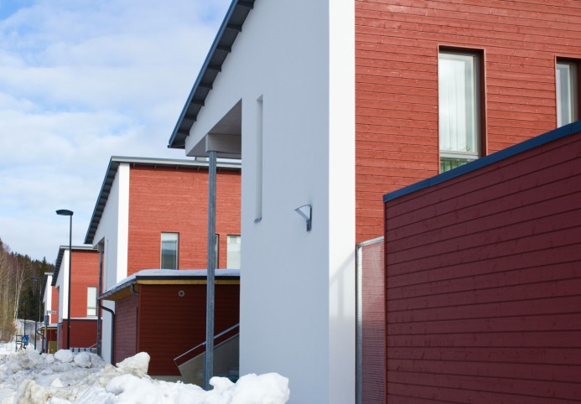
Products for exterior claddings
-top coats
Ultra Pro, matt paint
Ultra Pro 30, semi-matt paint
Ultra Pro Plus 30, semi-matt paint, highest quality
-Fast drying primer and top coat
-New type of polyacrylic binder
-Drying time 5-10 min in conventional + ir -drying unit.
-Typical drying temperature 30-40°C
-Good stacking properties
-Color card for exterior paints
-White, A- and C-bases for tinting
-Excellent water absorption properties
-Room temperature drying possible for Ultra Pro Plus 30, Ultra Pro 30 but
conventional drying in temp. 30-40°C is needed for
Ultra Pro

Slide 7
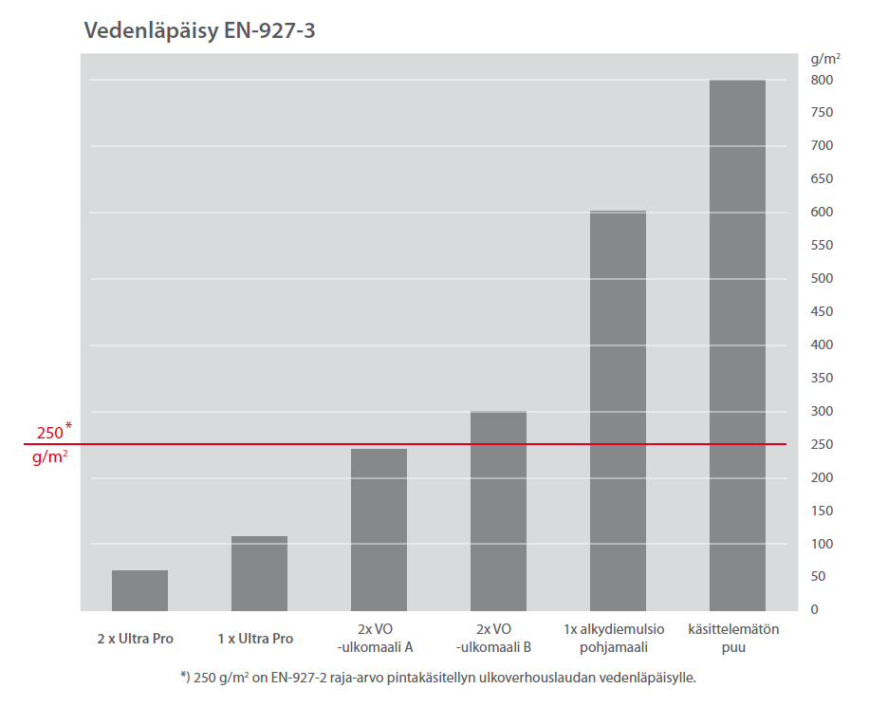
Products for exterior claddings
-top coats
Water absorption of Ultra Pro
Benefits of Ultra Pro products: Water absorption test
-Can be used as primer and top coat
->only one product needed for factory
-Fast drying and excellent stacking properties
-Fast painting rhythm
-Exellent adhesion and very low water absorption
-Wide color range

Slide 8
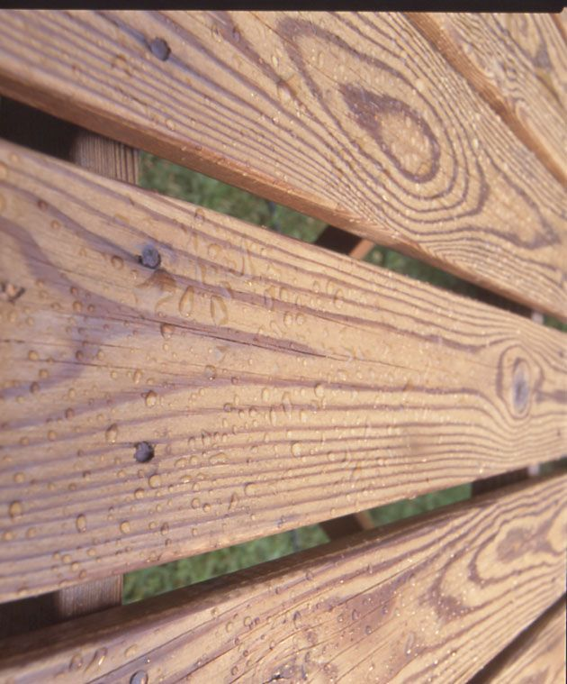
Products for exterior claddings
-priming oils
Pinja Priming Oil (registered wood preservative)
Pinja Wood Stain
Pinja Color Oil
-First layer in paint system
-Clear water borne impregnation agent
-Very good penetration properties
-Best rot and fungiside protection

Slide 9
Typical painting systems
-Primer system
-Primer + top coat system
-Priming Oil + primer + top coat system
-Only top coat system
Primer system:
1x Pinja Pro Primer
or
1x Pinja Opti Primer
-Application 120-160 g/m²
-Temporary protection for 6-9 months
-Top coat painting recommended as soon
as possible on construction site

Slide 10
Typical painting systems
Primer + top coat systems:
1x Pinja Pro Primer
1x Pinja Pro or Pinja Top
1x Pinja Opti Primer
1x Pinja Pro or Pinja Top
1x Pinja Pro Primer
1x Ultra Pro or Ultra Pro 30 or Ultra Pro Plus 30
-All layers 120-160 g/m²

Slide 11
Typical painting systems
Priming oil + primer + top coat systems:
1x Pinja Priming Oil
1x Pinja Pro Primer
1x Pinja Pro or Pinja Top
1x Pinja Priming Oil
1x Pinja Opti Primer
1x Pinja Pro or Pinja Top
1x Pinja Priming Oil
1x Pinja Pro Primer
1x Ultra Pro or Ultra Pro 30 or Ultra Pro Plus 30
1x Pinja Priming Oil
2x Ultra Pro or Ultra Pro 30 or Ultra Pro Plus 30
-All layers 120-160 g/m²

Slide 12
Typical painting systems
Top coat systems:
2x PinjaTop
or
2x Pinja Pro
or
2x Ultra Pro
or
2x Ultra Pro 30
or
2x Ultra Pro Plus 30
-All layers 120-160 g/m²

Slide 13
Typical painting systems
Top coat systems with priming oil:
1x Pinja Priming Oil
2x PinjaTop
1x Pinja Priming Oil
2x Pinja Pro
1x Pinja Priming Oil
2x Ultra Pro
1x Pinja Priming Oil
2x Ultra Pro 30
1x Pinja Priming Oil
2x Ultra Pro Plus 30
-All layers 120-160 g/m²

Slide 14
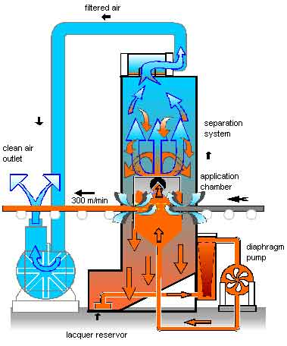
Typical application system for Pinja Pro Primer
Panel feeding Vacuum machine
Brushing/antidusting machine
Vacuum application Pinja Pro Primer 120-160 g/m²
Drying unit, convetional 30-40ºC, drying time 5-10 min
Cooling section
Stacking
-Pinja Pro Primer can be stacked when it is not competely dry
-Water-borne alkyd resin -good stacking properties
-Only for sawn wood (not planed)
-For planed wood Ultra Pro or Pinja Opti Primer

Slide 15
Typical application system for Pinja Pro Primer + Pinja Pro
Panel feeding
Brushing/antidusting machine
Vacuum machine (Pinja Pro Primer)
Spraying machine (Pinja Pro)
Drying unit, convetional 30-40ºC + ir-drying, drying time 5-10 min
Cooling section
Drying in shelves till next day
-First round Pinja Pro Primer 120-160 g/m²
-Second round Pinja Pro 120-160 g/m²
-Pinja Pro Primer application with vacuum machine
-Pinja Pro application with spraying machine
-Note that stacking properties of Pinja Pro and Pinja Top are not as
good as Ultra Pro

Slide 16
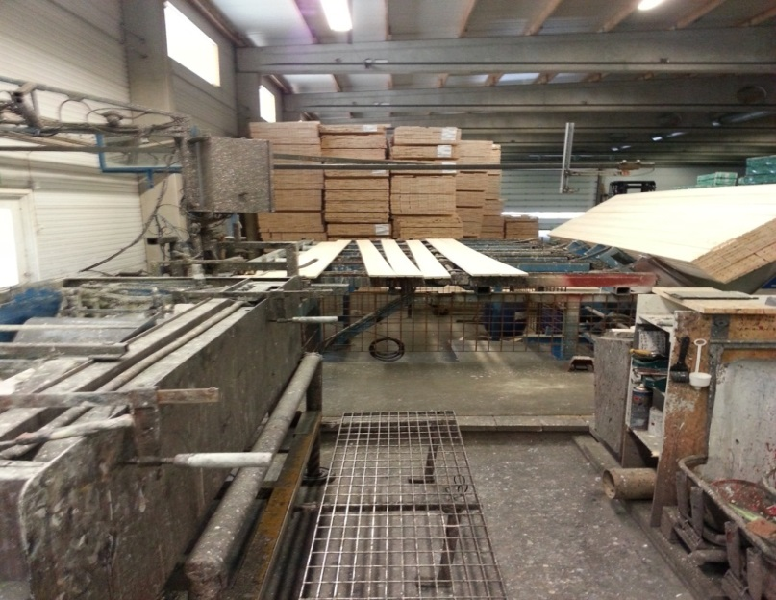
Typical application system for Ultra Pro or Ultra Pro 30
Panel feeding
Brushing/antidusting machine
Vacuum machine (Ultra Pro)
Spraying machine: 3-4 spray guns (Ultra Pro)
Drying unit, convetional 30-40ºC + ir-drying, drying time 5-10 min
Cooling section
Stacking
-First round Ultra Pro 120-160 g/m²
-Second round Ultra Pro 120-160 g/m²
-Ultra Pro application by spraying or vacuum machine
-Paint is stackable after 5-10 min drying time

Slide 17
Repainting of Pinja products
-All Tikkurila's Ultra, Pika-Teho and Vinha products are suitable for repainting
-Follow all quidelines and instructions of the repainting product

Slide 18
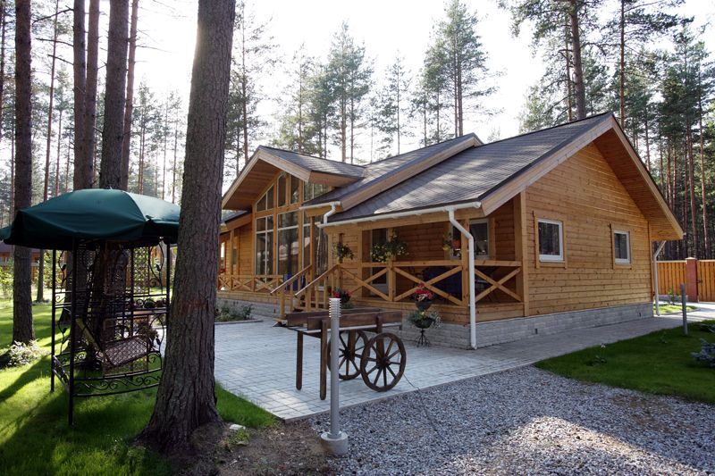
Water borne wood stains for exterior claddings
Pinja Wood Stain
-Tintable water borne wood stain
-Akvi Tone and also Avatint tinting
-Mostly used in window frame systems together with Pinjalac HB lacquer
-Also suitable for claddings etc. without lacquer
-Dipping, flow coating, spraying, vacuum, brushing
Pinja Color
Pinja Color HB (higher viscosity)
-Tintable water borne wood stain
-Avatint tinting
-Claddings, garden furniture, log houses etc.
-Dipping, flow coating, spraying, vacuum coating, brushing
-Repainting with Valtti Color and Valtti Akvacolor

Slide 19
Wood stains for exterior claddings
Pinja W-Oil
-Tintable water borne wood oil
-Akvi Tone and Avatint tinting
-Good water repellency effect
-Less cracking of the wood
-Claddings, log houses, garden furniture, decking, etc.
Pinja Color Oil
-Tintable water borne wood oil
-Avatint tinting
-Very good penetration properties
-Deckings, terracies, garden furniture
-Repainting with Valtti Wood Oil, Valtti Color, Valtti Akvacolor

Slide 20
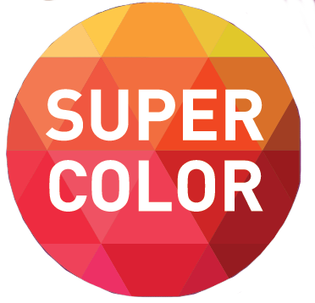
NEW Pinja Color Plus –woodstain which has long maintanance time
• Fast drying woodstain for claddings and glued log facades
• Higher solid content than normal wood stains -28 vol-%
• Clear and Super Color bases
• Super Color base contains transparent pigments which together with uv-protection agent gives superior sunlight protection
• Maintanance time up to 10 years
• Exellent water and humidity resistance minimise the cracking of the wood
• For planed and fine sawn wood as well as thermo and vacuum impregnated wood
Typical system:
1x Pinja Priming Oil or Pinja Wood Stain
2x Pinja Color Plus

Slide 21
Typical wood stain systems
-Manual or automatic spraying
-Vacuum and brushing machine application
-Dipping and flow coating application
-Similar systems to Pinja Color, Pinja Wood Stain, Pinja W-Oil
Only wood stain:
2x 80-120 g/m² Pinja Color
Priming oil and wood stain
1x 80-120 g/m² Pinja Priming Oil
2x 80-120 g/m² Pinja Color

Slide 22
Typical application system for Pinja Color
Panel feeding
Brushing/antidusting machine
Vacuum application (Pinja Color)
Drying unit, convetional 30-40ºC, drying time 5-10 min
Cooling section
Stacking
-Application 1-2 times 80-120 g/m²

Slide 23
Typical application and drying methods
-Spraying, manual or automatic spraying machine
-Vacuum machine
-Brushing machine
-Conventional + ir -drying tunnels or drying in room temperature
-Drying temperature in oven 30-45°C

Slide 24
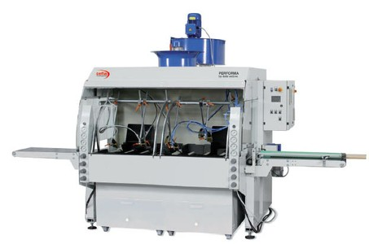
Spraying automate

Slide 25
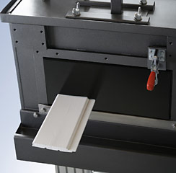
Vacuum machine

Slide 26
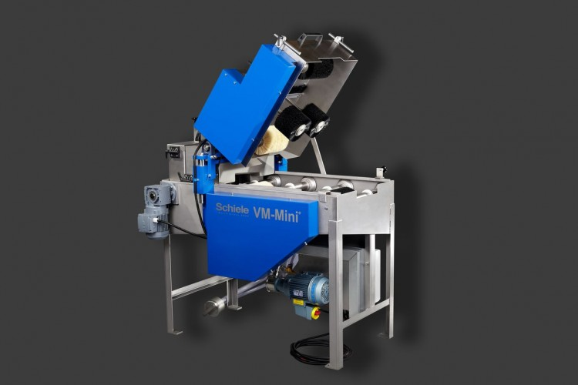
Brushing machine

Slide 27
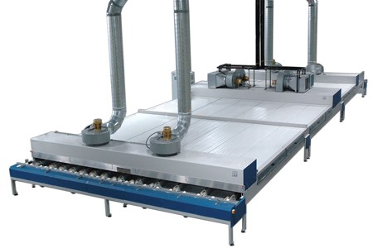
Horisontal and vertical drying ovens

Slide 28
Application videos
Vacuum machine application
https://www.youtube.com/watch?v=NW2Eg1WWh-c
Brushing machine application
https://www.youtube.com/watch?v=XzNJTh7vOQA

